Slide 1
THE CHANGING CONCEPT OF WORK:
WHEN DOES ATYPICAL WORK BECOME TYPICAL?
Prof. Dr. Paul Schoukens
Oslo, 22 September 2016

Slide 2
OVERVIEW
Defining typical work as standard work
New forms of work emerging between standard and non-standard work
Consequences for social security

Slide 3
TYPICAL WORK: THE MEANING OF A STANDARD - I
What is TYPICAL WORK?
Typical as ‘most common’
‘most common’
58% of the workforce in the EU is in indefinite full-time employment.
Typical as the ‘regulatory standard’
‘regulatory standard’
The «STABLE, OPEN-ENDED AND DIRECT EMPLOYMENT RELATIONSHIP BETWEEN A DEPENDENT, FULL-TIME EMPLOYEE AND THEIR UNITARY EMPLOYER» (Walton, 2016) became the standard for the regulation of the male labour market during Fordism because:
It provided a secured pool of middle-skilled workers.
It provided the income security needed for developing consumerism and the welfare State.
«STABLE, OPEN-ENDED AND DIRECT EMPLOYMENT RELATIONSHIP BETWEEN A DEPENDENT, FULL-TIME EMPLOYEE AND HIS UNITARY EMPLOYER» (Walton, 2016)

Slide 4
INTERNAL CHALLENGES TO THE STANDARD EMPLOYMENT RELATIONSHIP
TYPICAL WORK: THE MEANING OF A STANDARD - II
Employment relationship
Personal subordination
Economic dependency
Bilateral character
Mutuality of obligations
Salary
Work usually performed at the employer’s premises
Standard employment
Labour stability
Income security
Indefinite duration
Salary which is sufficient to ensure livelihood
Full-time
Expectation of an adequate level of social insurance

Slide 5
EXTERNAL CHALLENGES TO THE STANDARD EMPLOYMENT RELATIONSHIP - I
STANDARD EMPLOYMENT
(employees in a full-time permanent job)
58% EU employment
TEMPORARY EMPLOYEES
12% EU employment
PART-TIME EMPLOYMENT
20% EU employment
SELF-EMPLOYMENT
16% EU employment
Source: Eurostat, Labour status of persons aged 15 years and older, EU-28, 2014

Slide 6
EXTERNAL CHALLENGES TO THE STANDARD EMPLOYMENT RELATIONSHIP - II
Temporary agency work
Apprenticeships
PART-TIME
Marginal work
FIXED-TERM
Crowd work
Economically dependent self-employed
Freelance work
SELF-EMPLOYMENT

Slide 7
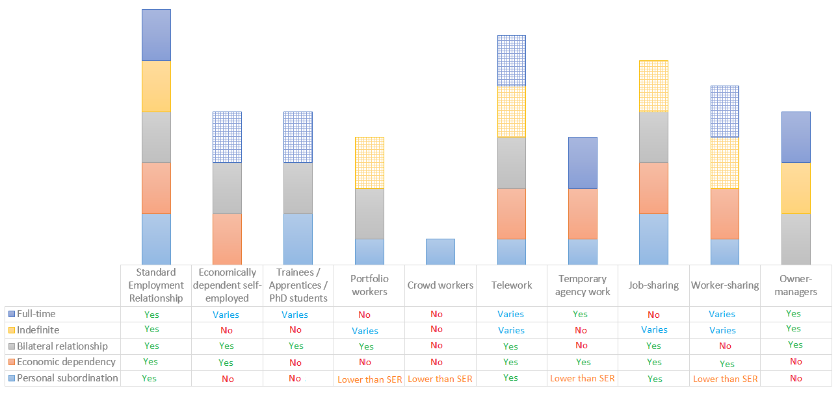
EXTERNAL CHALLENGES TO THE STANDARD EMPLOYMENT RELATIONSHIP - III

Slide 8
EXTERNAL CHALLENGES TO THE STANDARD EMPLOYMENT RELATIONSHIP - IV
Economically dependent self-employed
Trainees / Apprentices / PhD students
Portfolio workers
Temporary agency work
Owner-managers
Crowd workers

Slide 9
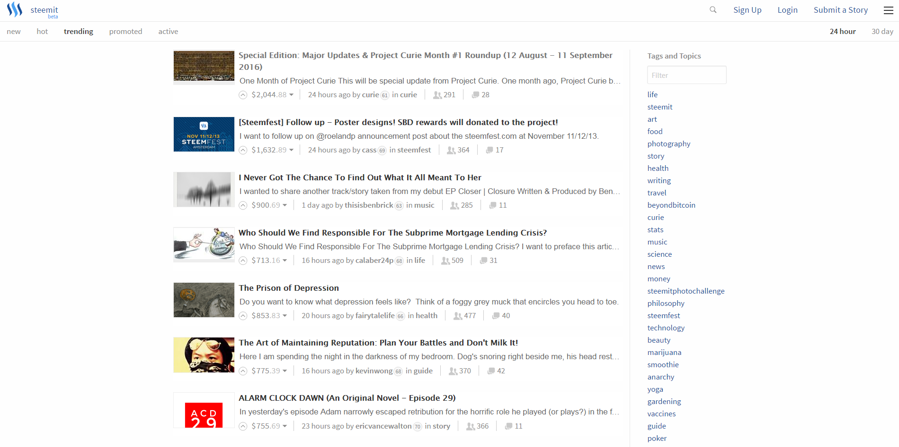
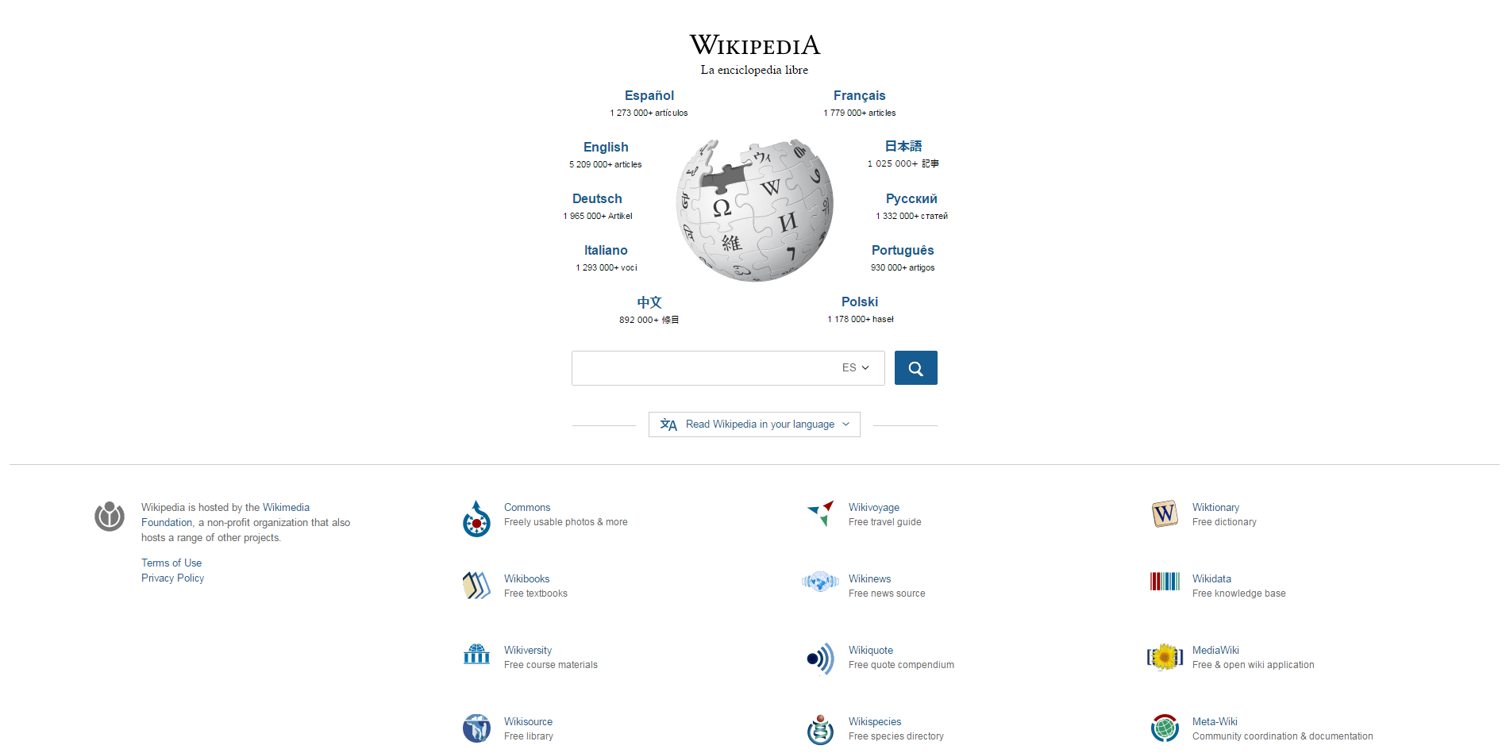
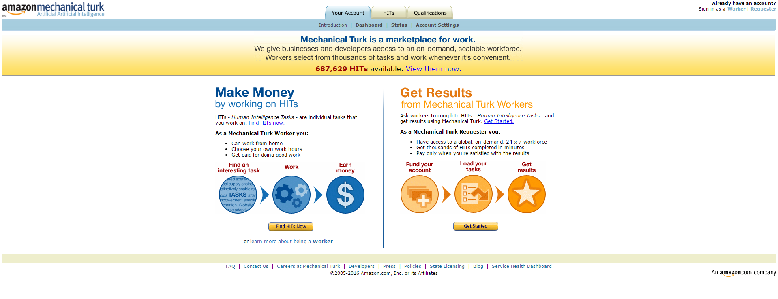

Slide 10
HOW NON-STANDARD WORK CHALLENGES SOCIAL SECURITY SYSTEMS?
Why is important for
Social Security?
How is challenged by
non-standard forms of work?
Persons in work earn a salary
Unpaid work: Employee shareholder, trainees / apprentices / PhD students, crowd workers, prosumers …
To define ‘work’
Persons not in work need to find work
Unpaid work
Marginal work?
Employer is responsible for contributions
Issue of classification: Bogus self-employed, owner managers, employee shareholders …
Multiple employers: Temporary agency, crowd work
To detect employer
Employer decides on redundancy
Zero-hours contracts: Both sides may refuse work
Lack of labour / income stability
Thresholds in social insurance schemes
Very small number of hours / low income
Difficult to track hours

Slide 11
CONCLUSION
The standard employment relationship is still typical in numerical terms, but it is stopping to be typical as a regulatory model
This produces challenges for social security
To adapt technically the system to the specificities of non-standard work
Leaving Fordism: From stable work to work
Subsidizing non-standard work? Position of Basic Income?
Social Security itself conducting to poverty

Slide 12
Thank you

